Slide 1

Module 3
Things around us
Unit 7
Seasons

Slide 2
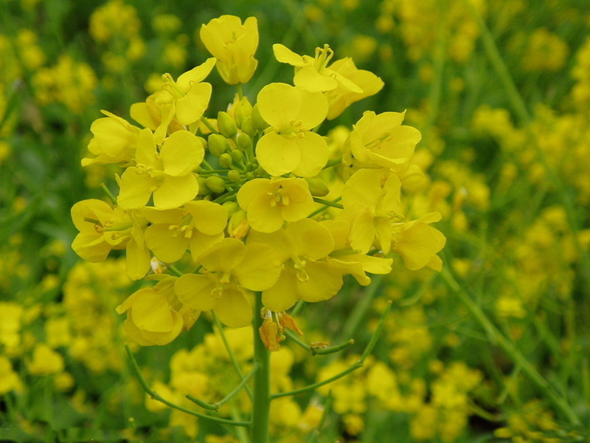
spring

Slide 3
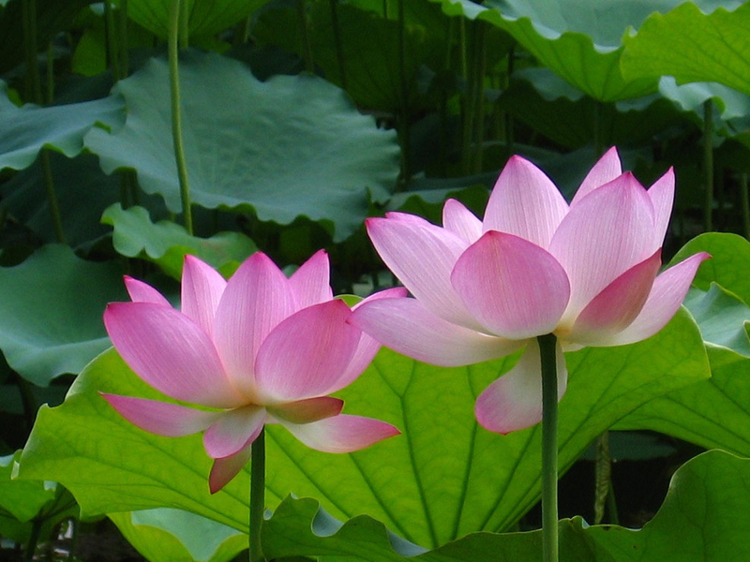
summer

Slide 4
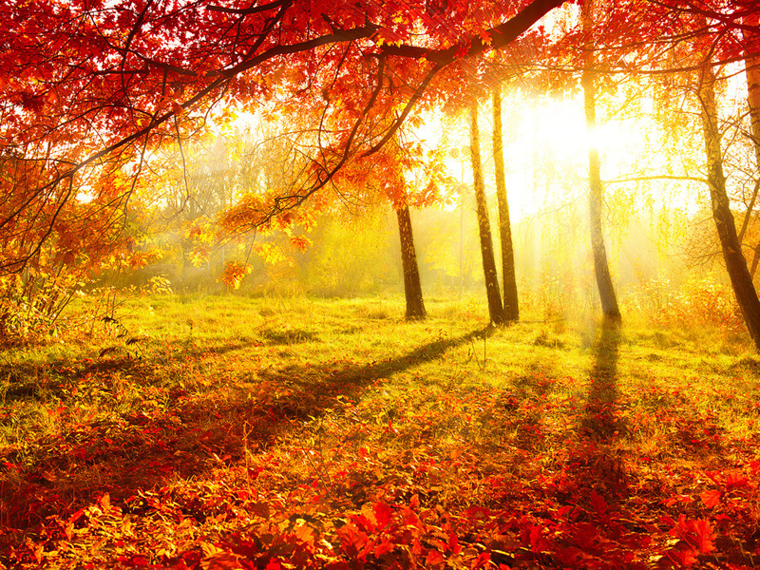
autumn

Slide 5
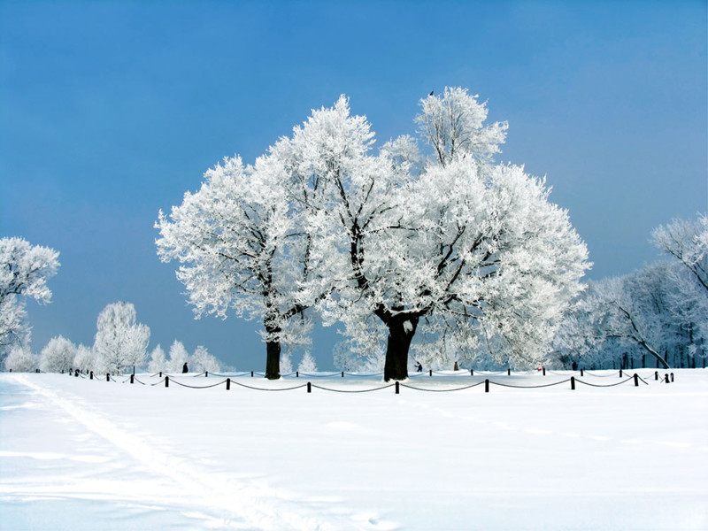
winter

Slide 6
Practice!

Slide 7
看图填单词：
___________________
___________________
___________________
___________________
spring

Slide 8
___________________
___________________
___________________
___________________
summer

Slide 9
___________________
___________________
___________________
___________________
autumn

Slide 10
___________________
___________________
___________________
___________________
winter

Slide 11
猜猜哪个单词消失了？
spring
autumn
summer
winter

Slide 12
autumn
spring
summer
winter

Slide 13
spring
summer
autumn
winter

Slide 14
winter
autumn
spring
summer

Slide 15
Thank you!

